Slide 1
Ewastage

Slide 2
Introduction:
E-waste is a term used to cover all things of electrical and electronic equipment (EEE) and parts have been disposed of by its proprietor as waste without the goal of reuse. E-waste is a serious issue in all developed and developing countries as it has given significant challenges towards the waste management system. Owing to the rapid development of technologies, marketing and compatibility issues, the lifespan of electrical and electronic goods become considerably shortened, that becomes emerging global and local concern today due to the increasing amount of it

Slide 3
Continue:
E-waste Management System is a web portal developed to automate the process of recycling the E-waste products. This application can be accessed by the admin, sellers and buyers. The sellers, those who want to sell the E-waste can sign up with the following details like name, phone, email, address & city. After registration they can login and post the E-waste details with product image, quantity with product description. The admin will review those details and he will update the price inclusive of fixed service charge and he will approve it. Once it is approved the e-waste product posting will go live.

Slide 4
The buyer should sign up with this application and can login. Buyer can view and manage their profile. They can view the posted e-waste product details and send applications for the interested product. They can also view the seller contact and they can contact as well. Now the seller will receive the application and they can contact the buyer and can sell the e-waste. The buyer has to pay in the application and the admin will return the amount to the seller after deducting the service charge. The buyer has to go and pick up the e-waste. After sales the client will update the status as sold in the application.

Slide 5
Database Description:
E-waste Management System is a web application developed to automate
the process of recycling the E-waste products. This application can be accessed by the admin, sellers and buyers. The seller, those who want to sell the E-waste can sign up with the following details like name, phone, email, address & city. After registration they can login and post the E-waste details with product image, quantity with product description. The admin will review those details and he will update the price inclusive of fixed service charge and he will approve it. Once it is approved the e-waste product posting will go live. The buyer should sign up with this application and can login. Buyer can view and manage their profile. They can view the posted e-waste product details and send an application for the interested product. They can also view the seller contact and they can contact as well. Now the seller will receive the application. They can contact the buyer and sell the e-waste. The buyer has to pay in the application and the admin will return the amount to the seller after deducting the service charge. The buyer has to go and pick up the e-waste. After sales the client will update the status as sold in the application.

Slide 6
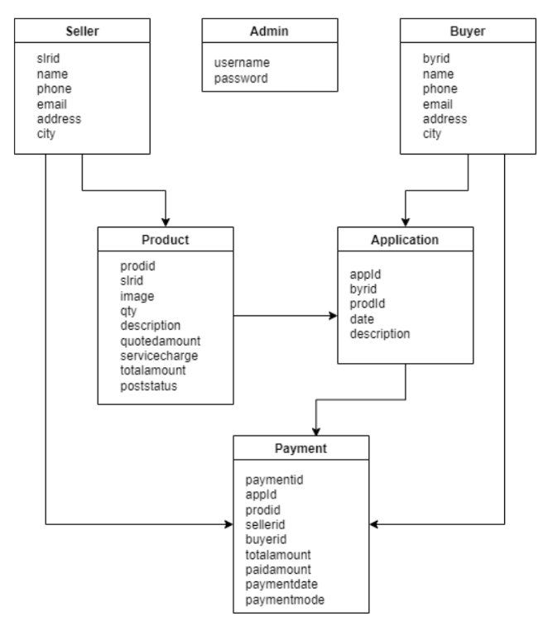

Slide 7
Administrative:
Admin can view the sellers profile
Admin can view the buyer profile
Admin can view the E waste products.
Admin can view buyer applications

Slide 8
Seller :
Seller can edit their profile
Seller can add new e waste product
Seller can delete or edit the products
Seller accept the product
Seller can deduct the amount

Slide 9
Buyer:
Buyer can view and edit their profile
Buyer can view the products
Buyer can apply for product
Buyer can view applied products

Slide 10
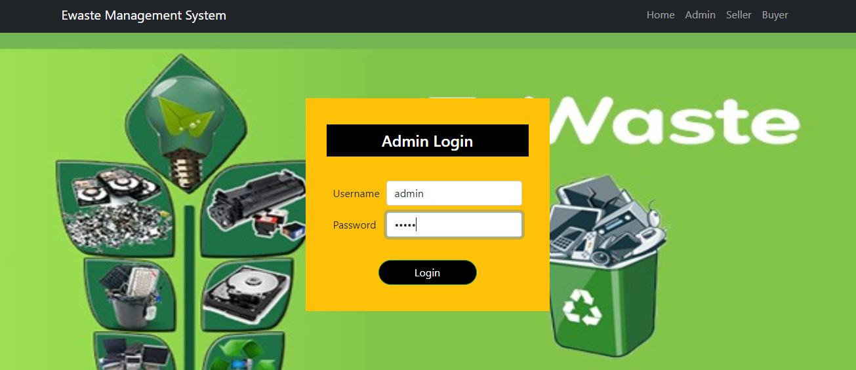
Admin Login:

Slide 11
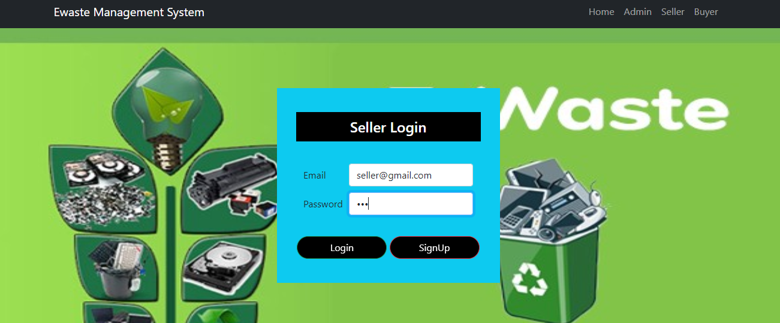
Seller Login:

Slide 12
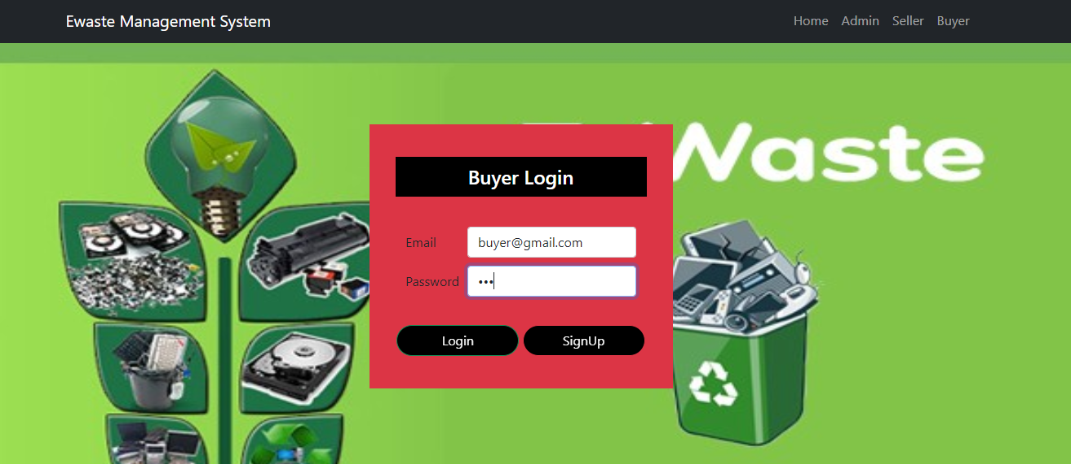
Buyer Login:

Slide 13
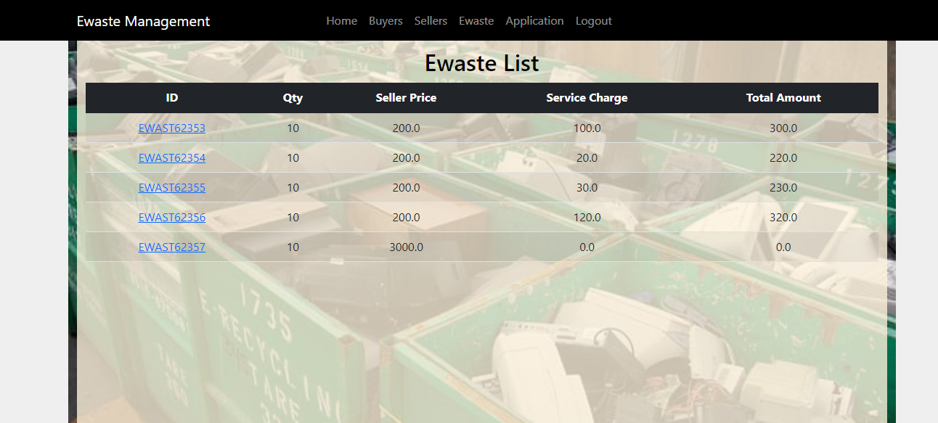
View E Waste Products:

Slide 14
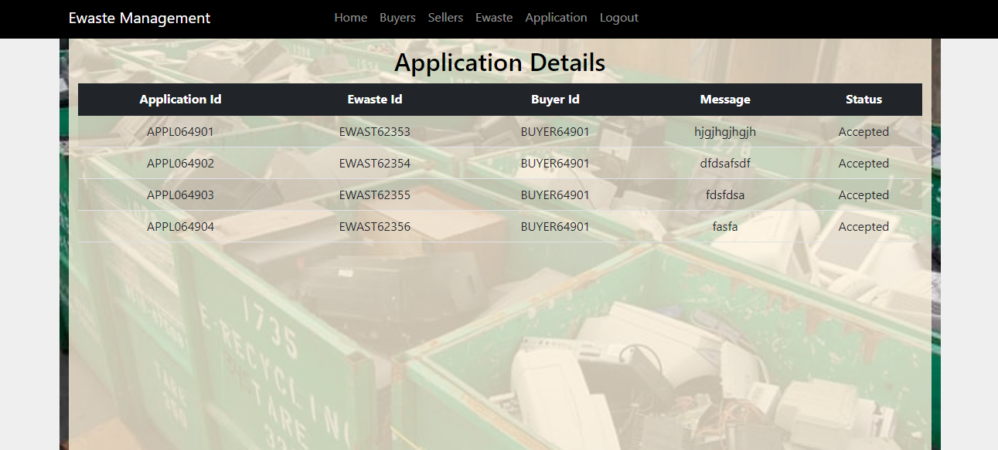
View Applied Products:

Slide 15


Slide 16


